Slide 1
Neurotransmitters
Dr Reshmy K.R
Professor
Dept.of Physiology
SKHMC

Slide 2
The chemical substances that acts as the mediator for the transmission of impulse from one neuron to another neuron through a synapse.
Neuro transmitters , hormones and other chemical messengers which modify the synaptic transmission - neuromodulators

Slide 3
Criteria for Neurotransmitter
1. It must be found in a neuron
2.It must be produced by a neuron
3. It must be released by a neuron
4. After release, it must act on a target area and produce some biological effect
5. After the action , it must be activated

Slide 4
Classification of Neurotransmitters
I. Depending upon chemical nature
1. Aminoacids
---involved in fast transmission and are inhibitory and excitatory in action, GABA, glycine, glutamate aspartate

Slide 5
2. Amines
---involve in slow synaptic transmission
both inhibitory and excitatory in action
Noradrenalin
Adrenalin
Dopamine
Serotonin
Histamin

Slide 6
3. Neuropeptides
--- short chain peptides
slow acting synaptic transmitters

Slide 7
4. others
Acetyl Choline- formed from the choline and acetyl co-enzyme A in the presence of enzyme choline acetyl transferase

Slide 8
II. Depending upon function
1. Excitatory Neurotransmitters
- Responsible for the conduction of impulses from the presynaptic neuron to the post synaptic neuron.
the neurotransmitter released from the presynaptic axon terminal does not cause development of action potential in the post synaptic neuron.
-- It causes some changes in the resting membrane potential- slight depolarization by the opening of sodium channels in the post synaptic membrane and influx of Na ions from ECF.

Slide 9
--The slight depolarization is called excitatory postsynaptic potential (EPSP)
EPSP in turn causes development of action potential in the intial segment of the axon of the post synaptic neuron
The common excitatory neurotransmitters are acetylcholine & Noradrenaline

Slide 10
2. Inhibitory Neurotransmitters
-- Inhibits the conduction of impilse from the presynaptic neuron to the postsynaptic neuron.
when it is released from the presynaptic axon terminal due to the arrival of action potential , it causes opening of K channels in the postsynaptic membrane and efflux of K ions.
-- this leads to hyperpolarization -- Inhibitory post synaptic potential (IPSP)

Slide 11
When IPSP is developed, the action potential is not generated in the postsynaptic neuron.
The common inhibitory neurotransmitters are Gamma aminobutyric acid and Dopamine.

Slide 12
Transport and release of Neurotransmitter
The neurotransmitter is produced in the cell body of the neuron and is transmitted through the axon.
in the axon terminal , the neurotransmitter is stored in small packets --vesicles.

Slide 13
Under the influence of a stimulus, these vesicles open and release the neurotransmitter into the synaptic cleft.
It binds to specific receptors on the surface of the postsynaptic cell.
The receptors are G proteins. protein kinase or ligand gated receptors.

Slide 14
Inactivation of Neurotransmitter
After the exceution of the action , neurotransmitter is inactivated by four different mechanisms
1. it diffuses out of synaptic cleft to the area where it has no action
2. It is destroyed or disintegrated by specific enzymes
3.It is engulfed and removed by astrocytes
4. It is removed by reuptake process, the neurotransmitter is taken back into the axon terminal from where it was released

Slide 15
1. Acetyl choline
-Cholinergic neurotransmitter-Excitatory function
it is released from the nerve endings of
1. preganglonic parasympathetic nerve
2. Post ganglionic parasympathetic nerve
3. Preganglionic sympathetic nerve
4. post ganglionic sympathetic cholinergic nerves
-nerves supplying eccrine sweat glands
-Sympathetic vasodilator nerves in skeletal muscle

Slide 16
5. Nerves in amacrine cells of retina
6. Many regions of brain
Acetyl choline is synthesized in axon terminal and stored inside the vesicles, quick in action
It produces the exitatory function of synapse by opening the ligand gated Na channels
It is destroyed immediately after executing the action by the enzyme acetylcholinesterase present in the basal lamina of the synaptic cleft.

Slide 17
Noradrenalin
Neurotransmitter in adrenergic nerve fibers, involved in dreams, arousal, elevation of moods
It is released in the structures:
1. postganglionic sympathetic nerve endings
2.C.C
3.Hypothalamus
4. Basal ganglia
5.Brainstem
6. Locus ceruleus in pons
7. Spinal cord

Slide 18
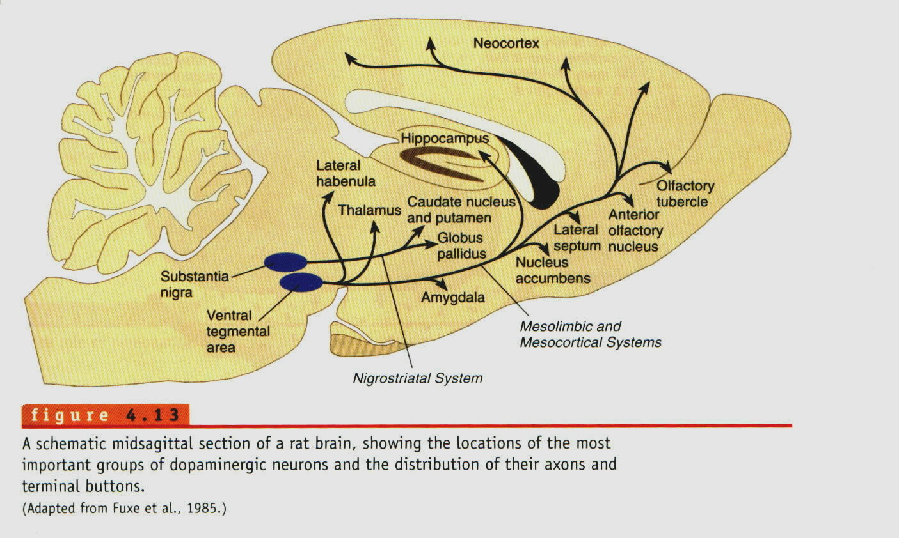
Dopamine
---secreted by nerve endings in
B.G, Hypothalamus, Limbic system, Neocortex,Retina
Inhibitory action
prolactin inhibitory hormone secreted by hypothalamus is dopamine

Slide 19
Serotonin
5- Hydroxy trptamine
syntesized from trptophan by hydroxylation and decarboxylation
large amount of serotonin is found in enterochromatin cells of GI tract
Small amount is found in platelets and nervous system

Slide 20
Serotonin
It is secreted in
-Hypothalamus, Limbic system, Cerebellum, Dorsal raphe nucleus of midbrain,Spinal cord,Retina, GI tract, Lungs, Platelets.
it impulses of pain sensation in post. gray horn of spinal cord.
cause depression of mood and sleep
Serotonin causes vasoconstriction, platelet aggregation and smooth muscle contraction
controls food intake

Slide 21
Histamin
-secreted in nerve endings of hypothalamus, limbic cortex and other parts of C.C
-Secreted by gastric mucosa and mast cells
excitatory neurotransmitter
impt. role in arousal mechanism

Slide 22
Gamma aminobutyric Acid
- Inhibitory neurotransmitter in synapse in CNS
-- Presynaptic inhibition
secreted by nerve endings of
-- C.C,Cerebellum, B.G,Spinal cord, Retina

Slide 23
Thank You

